Slide 1
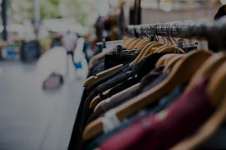
Shopping Customer Segmentation
An Unsupervised machine learning Project

Slide 2
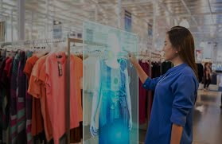
Segment Shopping
Customers
Problem Statement: understand the
Target Customers for the marketing team
to plan a strategy
Context: My marketing team wants me to identify the most important shopping groups based on income, age, and the mall
shopping score.
The team also wants the ideal number of groups with a label for each.

Slide 3
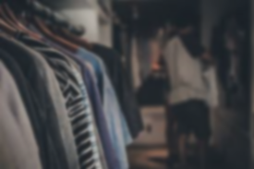
Objective : Market
Segmentation
• Divide your mall target market
into approachable groups.
Create subsets of a market
based on demographics
behavioral criteria to better
understand the target for
marketing activities.

Slide 4
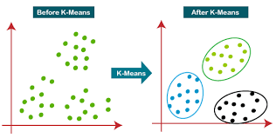
The Approach
Perform some quick EDA
(Exploratory Data Analysis)
2. Use KMEANS Clustering Algorithm
to create our segments
3. Use Summary Statistics on the
clusters
4. Visualize

Slide 5



Requirements
1. Standard Python Installation
2. Jupyter Notebook
3. Power point

Slide 6
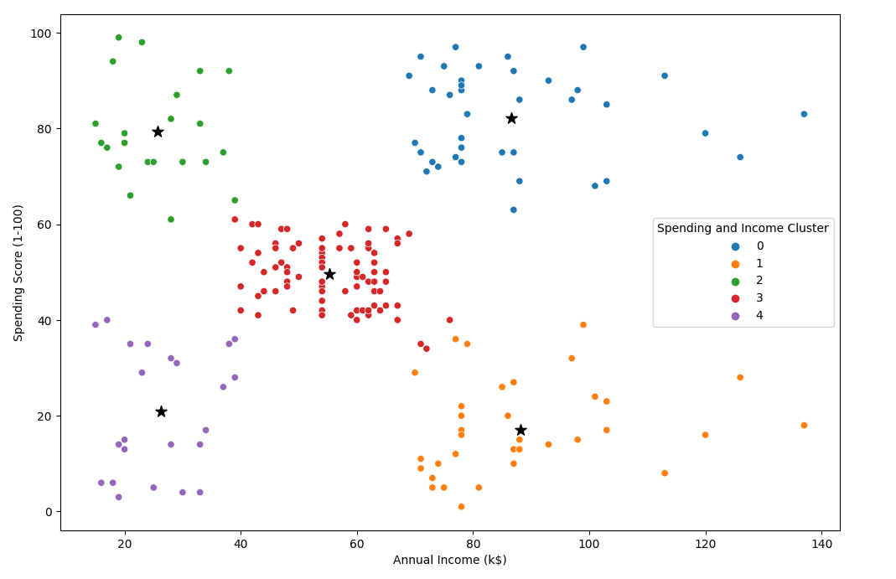
Analysis
Target Cluster
Target group would be cluster 1 which has high spending score and high income
60 % of cluster 1 shoppers are women. We should look for ways to attract these customers using a market campaign targeting popular items in this cluster.
Cluster 2 represents an interesting opportunity to market to the
Cluster 2 presents an interesting
opportunity to market to the
customers for sales event on
popular items.

